Slide 1
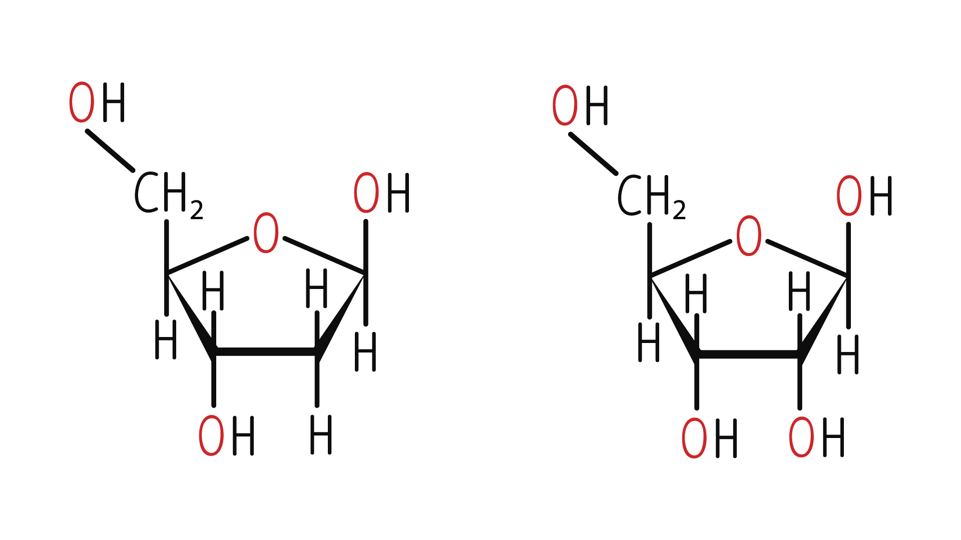
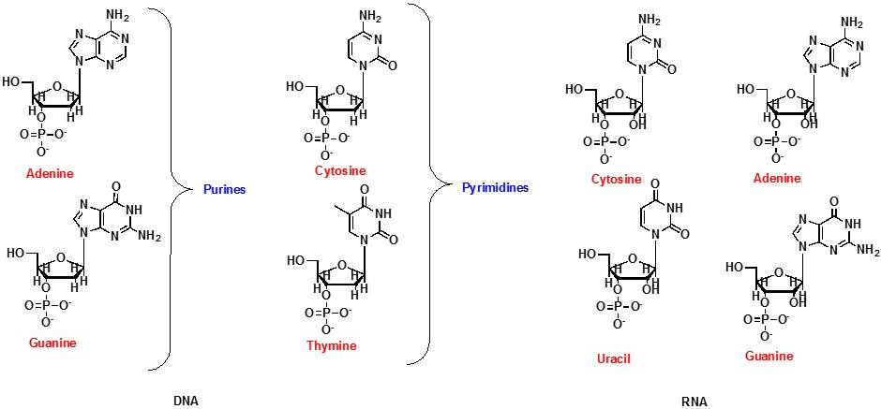
Nucleic Acids
Nucleic acids are the building blocks of life, essential for genetic information storage, replication, and expression
Two main types: DNA (deoxyribonucleic acid) and RNA (ribonucleic acid)
Composed of nucleotides that contain a sugar, a phosphate group, and a nitrogenous base
The ﻿chemical structures of deoxyribose (left) and ribose (right) sugars

Slide 2
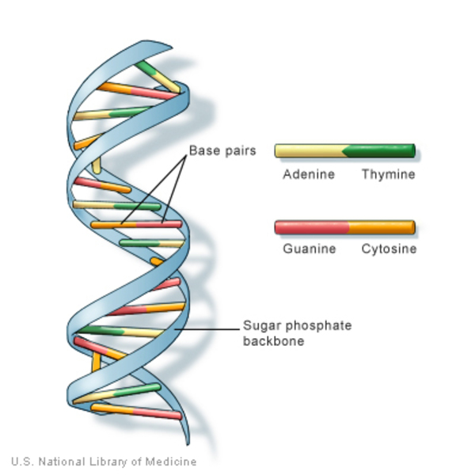
DNA
DNA is the genetic material that carries instructions for the development, functioning, growth, and reproduction of all living organisms.
It is a double-stranded helix, with two complementary strands that run in opposite directions.
The nitrogenous bases in DNA pair up in a specific manner: A always pairs with T, and C always pairs with G.

Slide 3
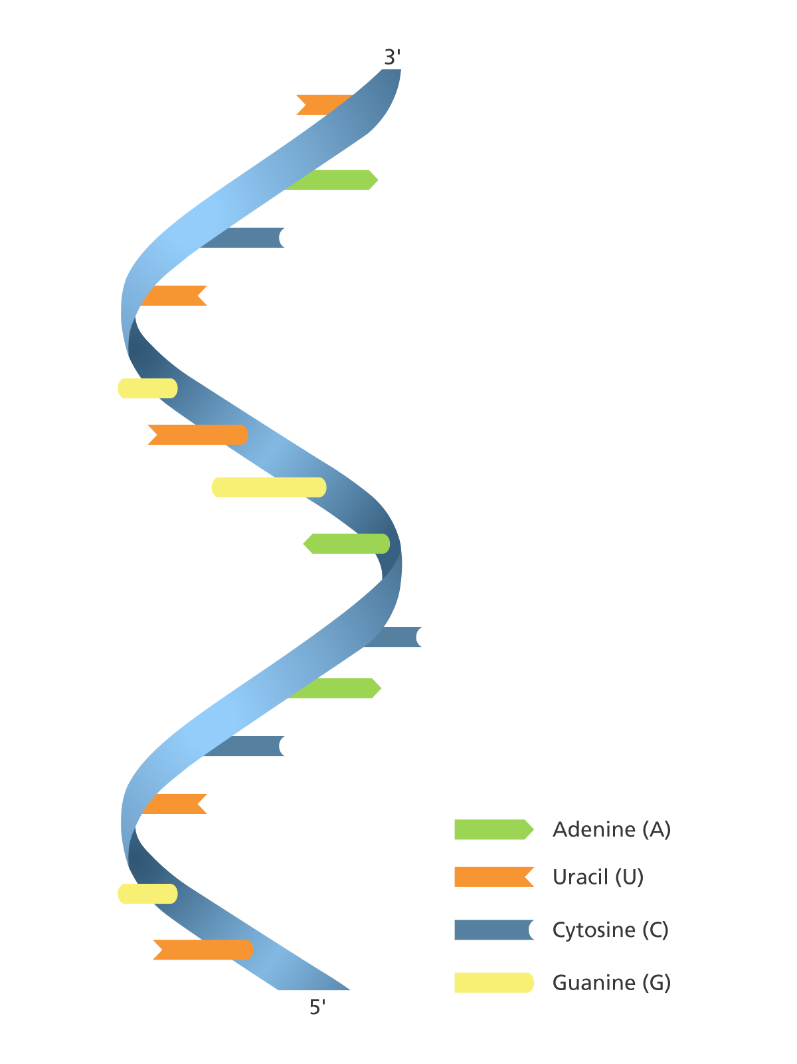
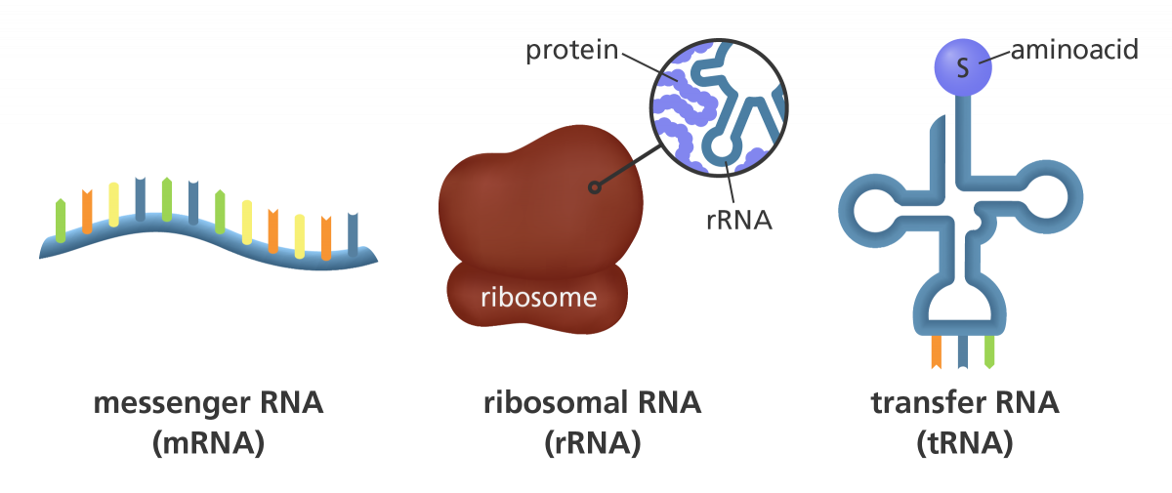
RNA
Single-stranded molecule
Four nitrogenous bases: adenine, guanine, cytosine, and uracil
Several types: mRNA, tRNA, rRNA

Slide 4
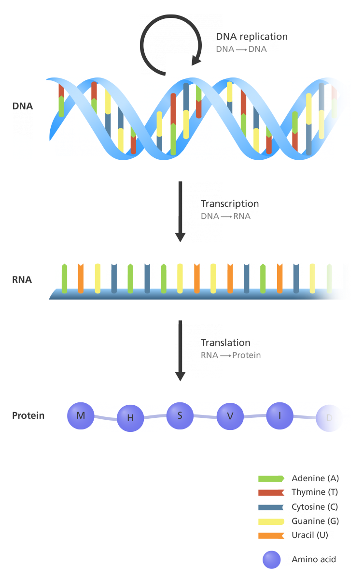
Central Dogma
Explains how genetic information flows in cells
Replication
Transcription
Translation
DNA is transcribed into mRNA, which is translated into proteins

Slide 5
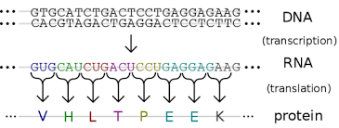

Slide 6
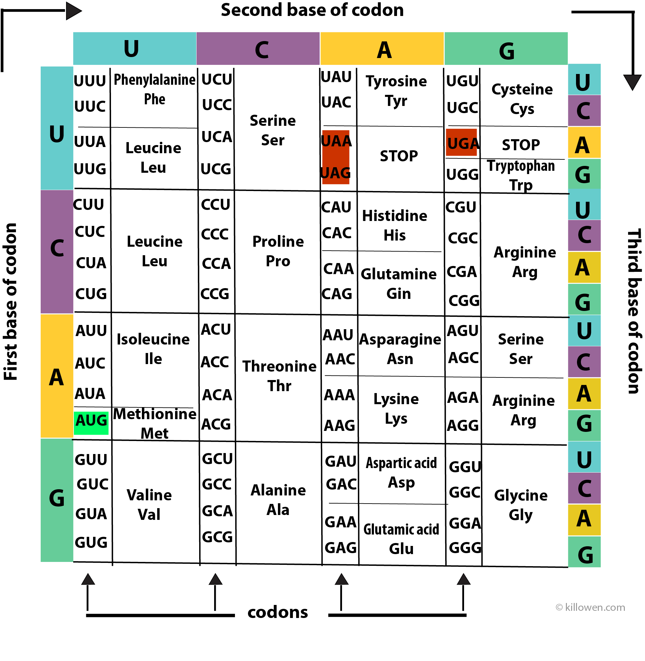
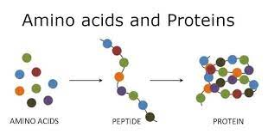
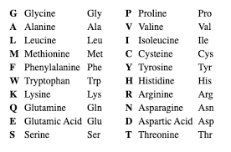

Slide 7
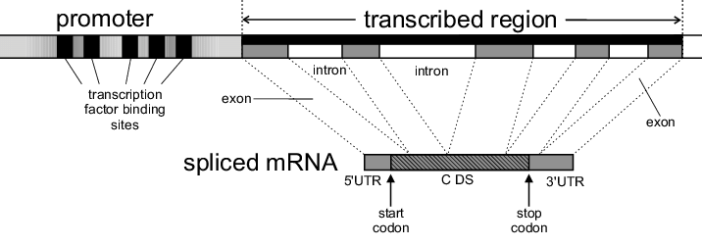
Gene structure in eukaryotes

Slide 8
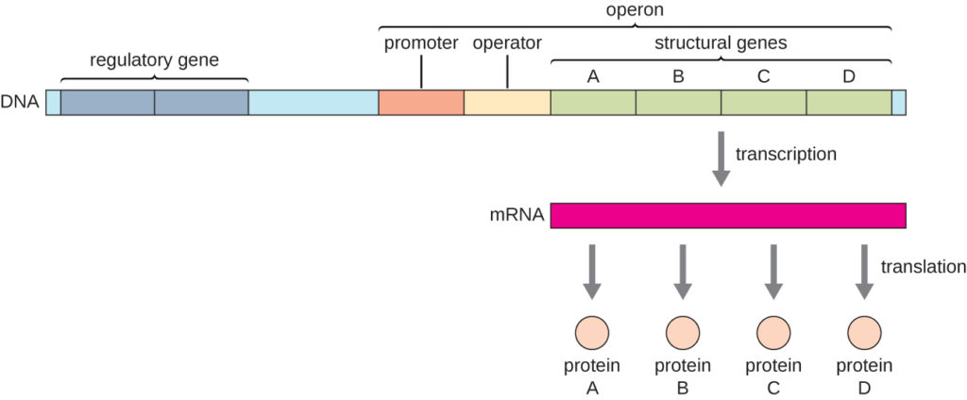
Gene structure in Prokaryotes

Slide 9
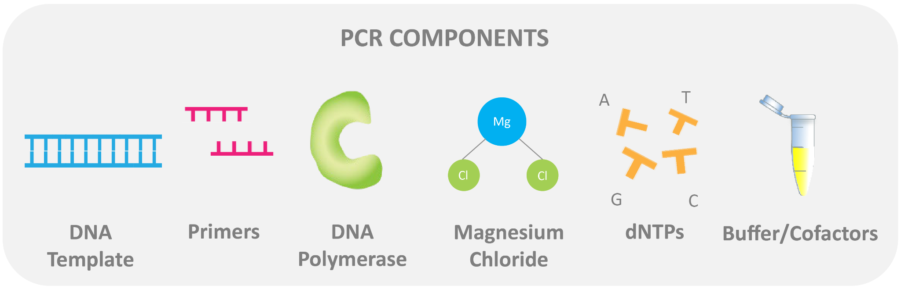
RT-PCR
A powerful diagnostic tool
Reverse transcription polymerase chain reaction (RT-PCR)
Converts RNA into DNA, then amplifies specific DNA sequences
Allows for the detection and quantification of RNA molecules, including viral RNA

Slide 10
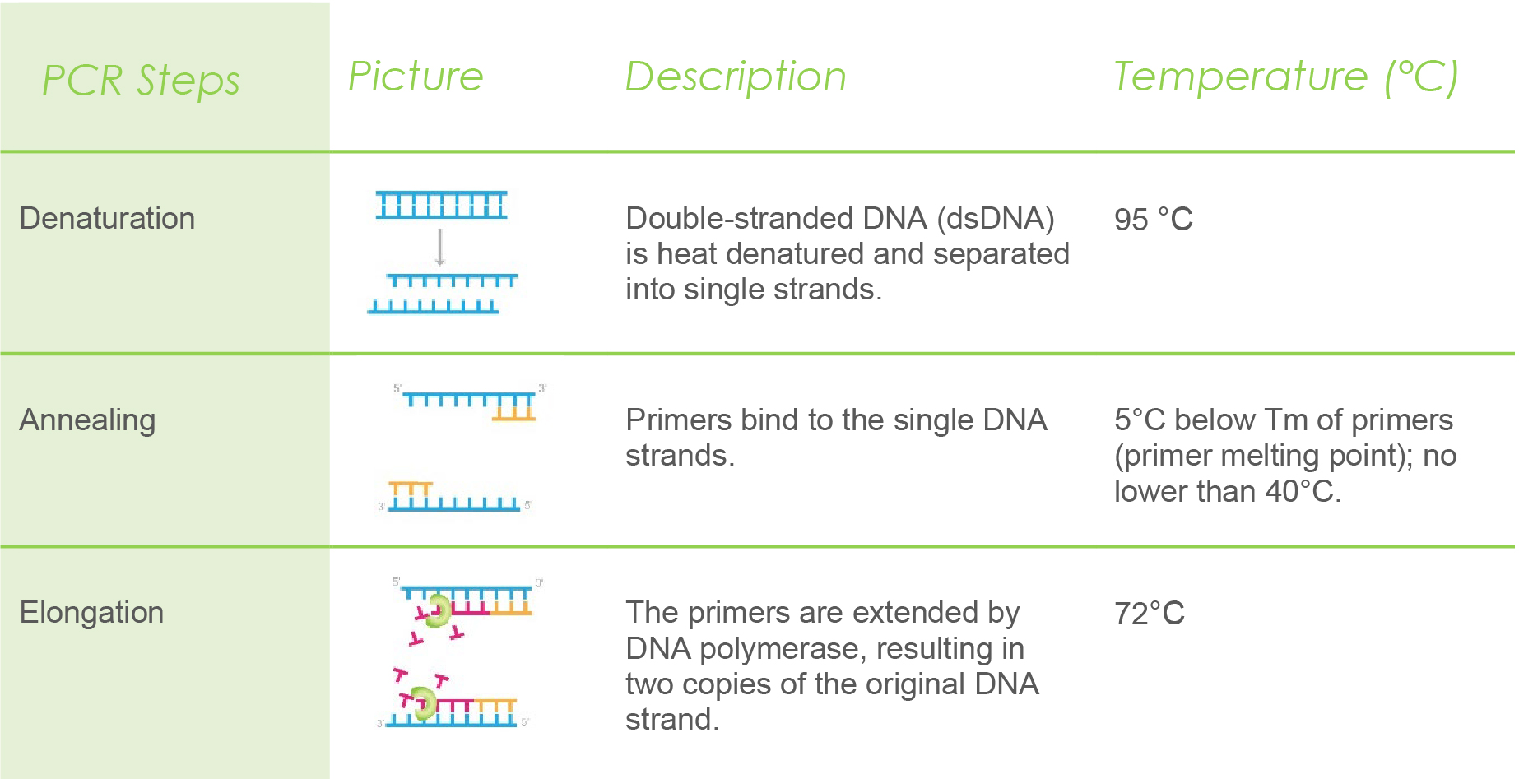

Slide 11
Applications of RT-PCR
COVID-19 diagnosis
Detection of other viral infections
Gene expression analysis
Cancer diagnostics
Forensic investigations

Slide 12
DNA Vaccine for Rabies
DNA vaccines represent a promising approach for the prevention of rabies, a deadly viral disease that affects the central nervous system.
DNA vaccines work by introducing a small piece of the rabies virus' genetic material into the body.
Once inside the cells, the DNA is translated into viral proteins, which are then presented to the immune system.
This triggers an immune response, including the production of antibodies against rabies.
Notes:
DNA vaccines represent a promising approach for the prevention of rabies, a deadly viral disease that affects the central nervous system. Traditional rabies vaccines are typically inactivated or attenuated virus vaccines, which may have limitations such as high cost and complex manufacturing processes. In contrast, DNA vaccines offer several advantages for rabies vaccination.
DNA vaccines work by introducing a small piece of the rabies virus' genetic material into the body, usually in the form of plasmid DNA. Once inside the cells, the DNA is translated into viral proteins, which are then presented to the immune system. This triggers an immune response, including the production of antibodies against rabies.
One of the key advantages of DNA vaccines for rabies is their simplified manufacturing process. DNA vaccines can be easily and cost-effectively produced compared to traditional vaccines, which may require laborious virus cultivation and purification steps. This makes DNA vaccines potentially more accessible for rabies control in resource-limited settings.
Another advantage of DNA vaccines is their rapid development potential. DNA vaccines can be developed and manufactured quickly in response to emerging outbreaks or changing viral strains. This allows for a more nimble response to the dynamic nature of rabies, which is endemic in many parts of the world and can present new challenges.
Safety is also a notable advantage of DNA vaccines for rabies. DNA vaccines do not contain live virus and do not replicate in the body, reducing the risk of adverse effects associated with live virus vaccines. This may improve the safety profile of DNA vaccines and enhance their acceptability for use in different populations.
Moreover, DNA vaccines have shown promising results in preclinical and clinical studies for rabies and other viral diseases. Some DNA vaccine candidates for rabies have demonstrated efficacy in animal models and early-stage human trials, although further research and clinical trials are ongoing to evaluate their safety and efficacy.
In conclusion, DNA vaccines for rabies hold promise as a potential alternative to traditional vaccines, offering advantages such as simplified manufacturing, rapid development, safety, and efficacy. Continued research and development in this field may lead to the availability of DNA vaccines for rabies that could contribute to the prevention and control of this deadly disease.
Regenerate response

Slide 13
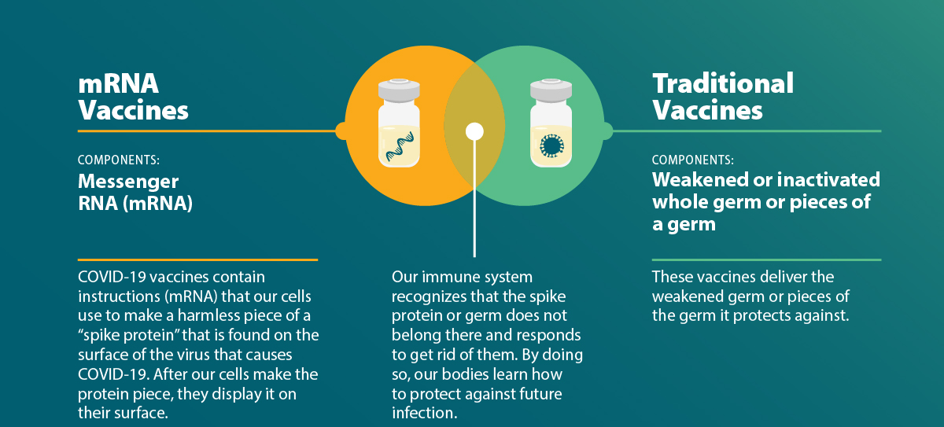
RNA vaccines for Covid19

Slide 14
Forensics – DNA fingerprinting
DNA fingerprinting, also known as DNA profiling or DNA typing, is a powerful tool used in forensics to identify individuals and solve crimes.
It involves analyzing specific regions of an individual's DNA to create a unique pattern, which can be compared to other DNA samples to determine their identity.

Slide 15
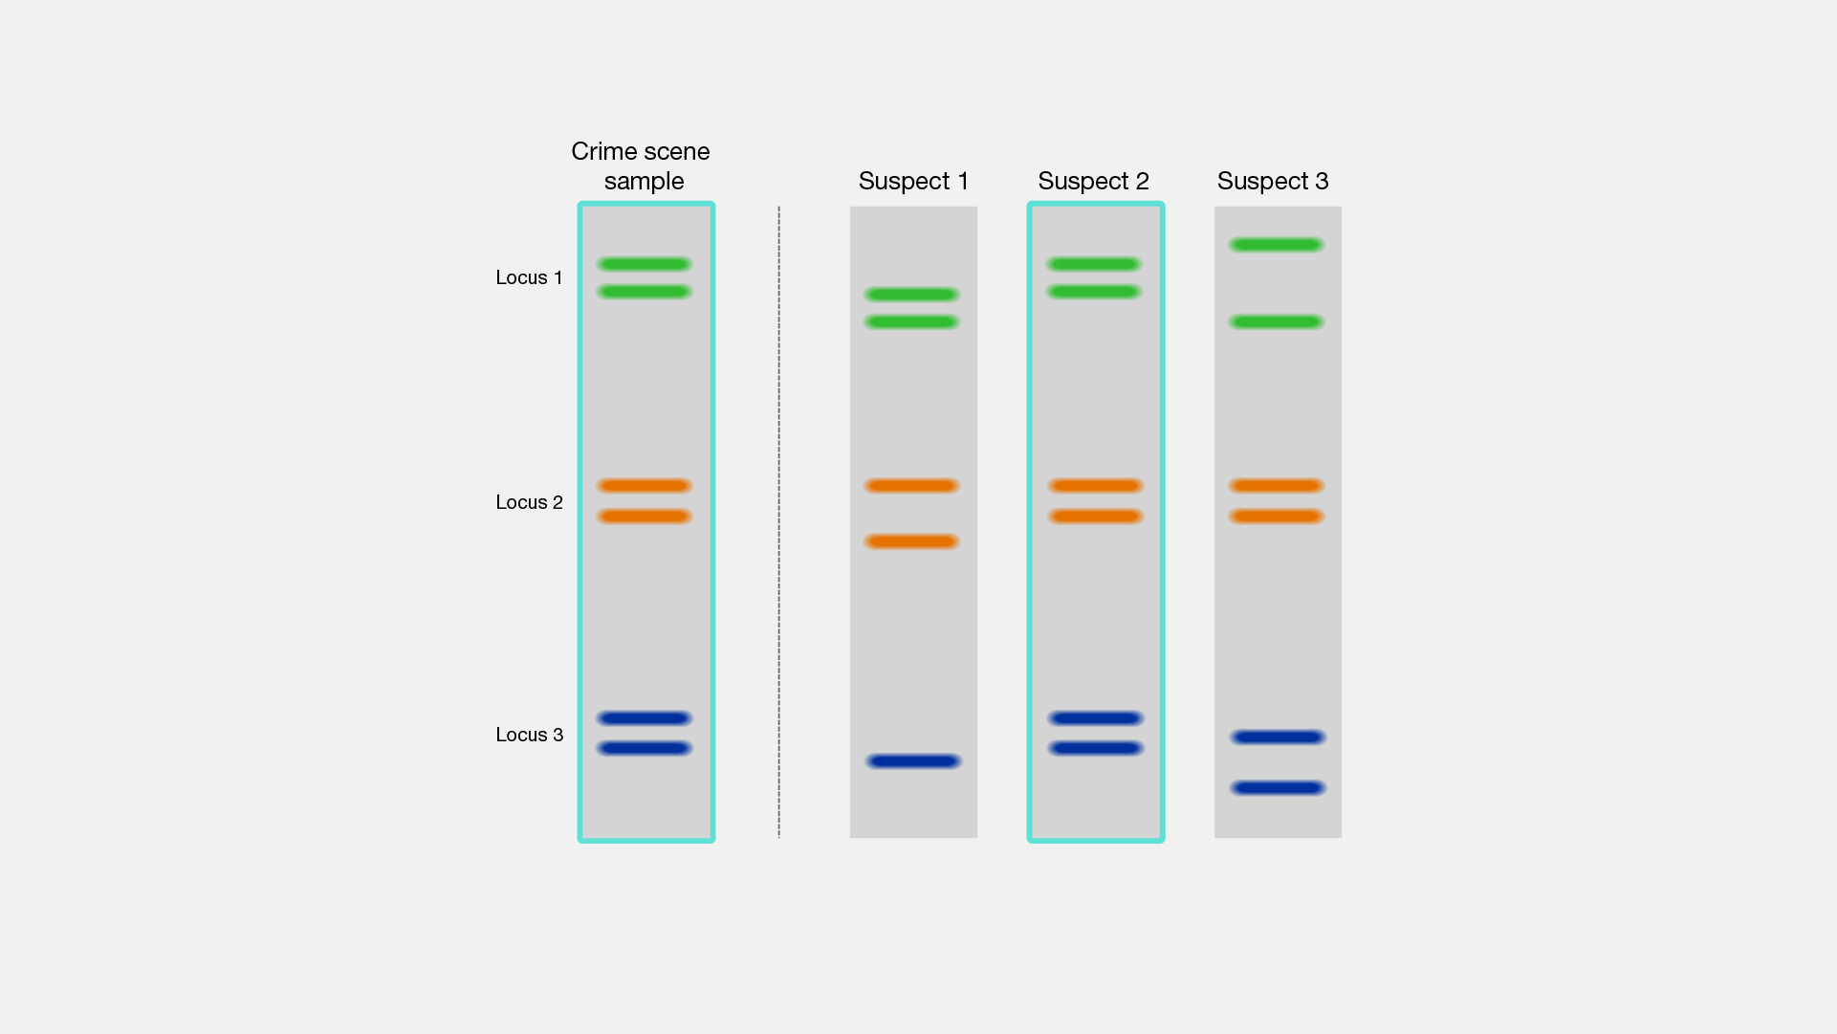

Slide 16
Conclusion
Nucleic acids are critical for life, and their study has revolutionized biology and medicine.
The central dogma provides a framework for understanding genetic information flow.
RT-PCR is a versatile tool that has transformed diagnostics and research.
DNA vaccines for rabies hold promise as a potential alternative to traditional vaccines, offering advantages such as simplified manufacturing, rapid development, safety, and efficacy.
The rapid development and authorization of RNA vaccines have played a crucial role in the global response to the COVID-19 pandemic
DNA fingerprinting is a powerful tool in forensic science for identifying individuals and solving crimes.

